Slide 1


SPM Presentation
Finance Tracking App
Muhammad Labeeb Tariq 2021-SE-15
Numan Ahmad 2021-SE-24
Wali Muhammad 2021-SE-39
Numan Danish 2021-SE-49
Farjad Waseem 2021-SE-56

Slide 2



TODAY'S AGENDA
1
Introduction
6
Risk Management
2
Project Scope
7
Development
3
Work Breakdown Structure (WBS)
8
Gantt Chart
4
Planning
9
Future Updates
5
Risk Analysis
10
Conclusion

Slide 3

INTRODUCTION
Problem Statement: Difficulty in managing personal finances effectively.
Solution: A mobile app to track expenses, create budgets, and monitor savings.
Objective: To develop a easy to use and secure personal finance management app.

Slide 4
WBS
Initiation: Defining scope, feasibility study, and team assembly.
Planning: Scheduling, resource allocation, and risk management.
Execution: Development, testing, and feedback collection.
Control: Quality checks, issue resolution, and stakeholder communication.
Closeout: Deployment, documentation, and project closure.

Slide 5
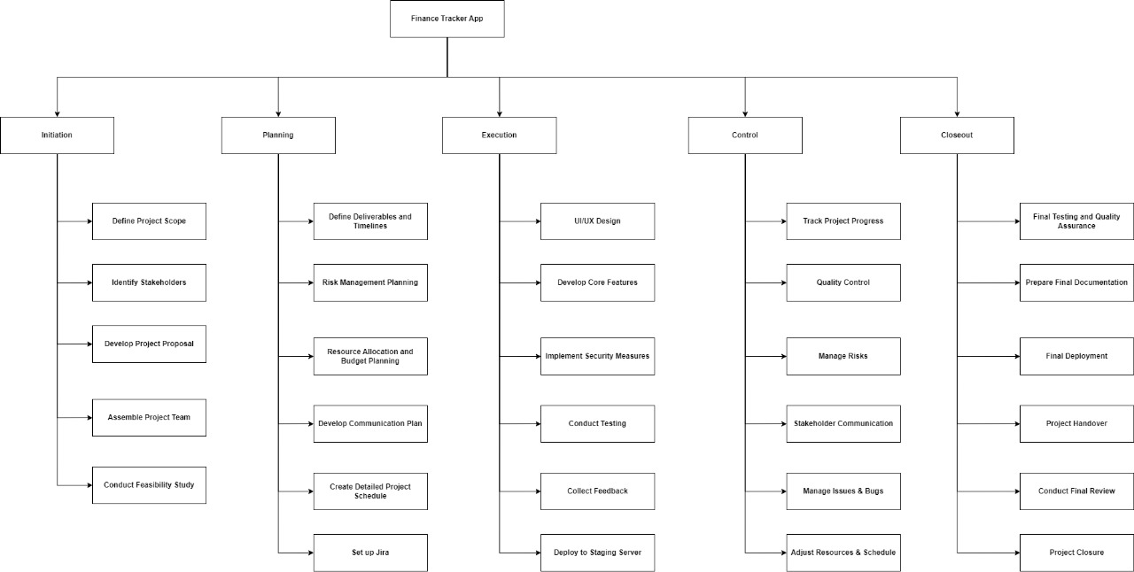
WBS

Slide 6


Tools and Technologies
Mobile Application
Project Management
Flutter (for cross-platform mobile app development).
Jira Software for task management, sprint planning, and progress tracking.
Version Control
Database
GitHub for code management and collaboration.
Firebase (fast and easy to use)
We help startups get media coverage and build relationships with relevant journalists and influencers.

Slide 7
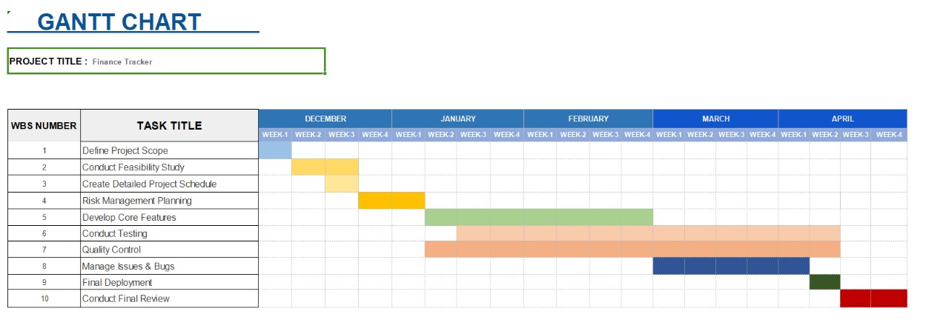
Gantt Chart

Slide 8
Risk Analysis
Risk Management Plan
Scope Creep (Growing Scope)
Technical Challenges
Resource Constraints
Schedule Delays
Poor Communication
Quality Issues
Risk Identification
Risk Assessment
Risk Mitigation Strategies
Risk Monitoring
Finance Tracking App

Slide 9
Group#7
THANK YOU
for your time and attention

